Slide 1

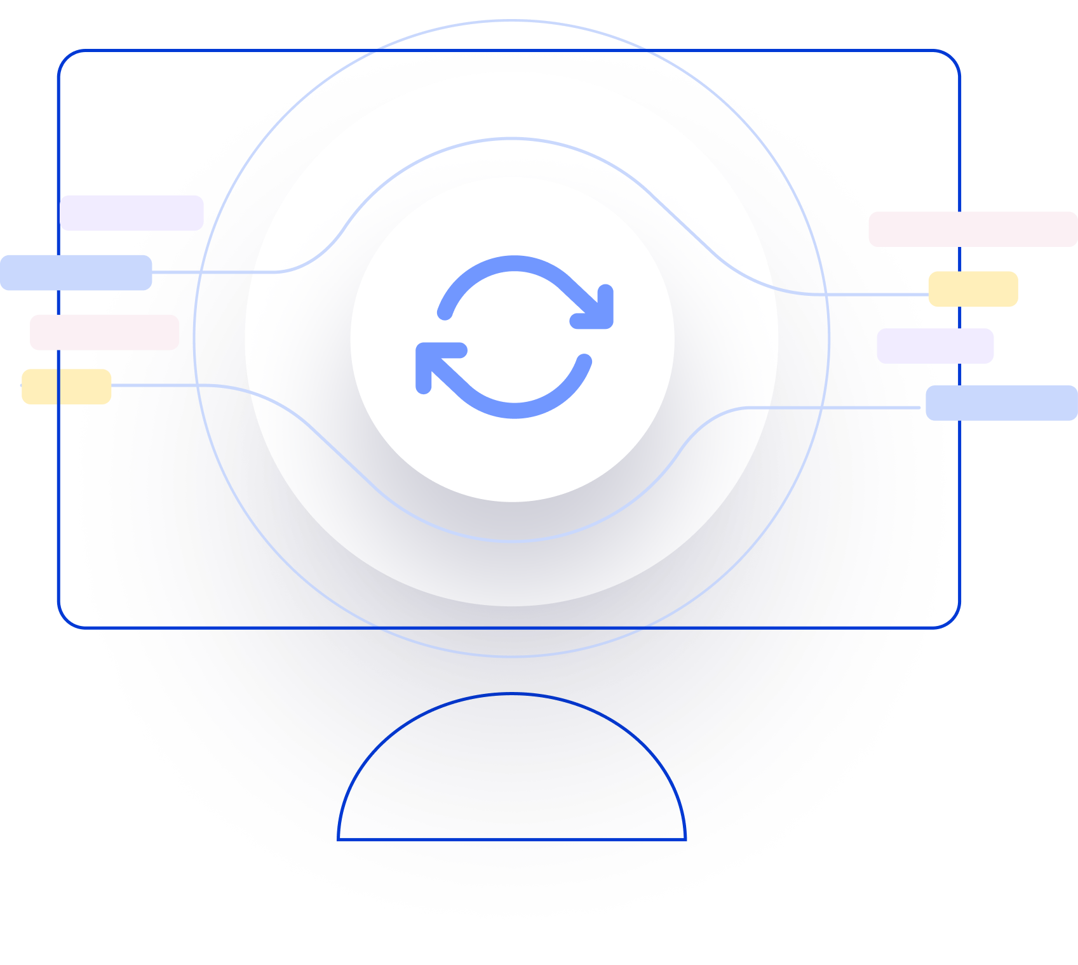

Next Generation AI for Document Automation – Accounts Payables
Weekly Report CW
#placeholder
January 2024

Slide 2


Slide 3
Agenda
RAID (Risks, Actions, Issues & Decisions) Follow-up
Project Status & Timeline Review
Highlight Topics

Slide 4
Risks – Focus on Open / In Response
RAID (Risks, Actions, Issues & Decisions) Follow-up
Status | Open at | Id | Description | Priority | Action Id | Action Description | Action Responsible | Action Status
Open | 2024-11-08 | R001 | Data Acquisition dependent on SAP addon release and installation - could break project timeline | High | A001 | ASK SAP DEV Team onboarding for integration implementation. ASK PM to raise resource request to the respective team and actively following up. |  | Open
Open | 2024-11-08 | R002 | Workflow integration might take more resources than expected | High | A002 | Discuss Solution Design extensively and support if needed |  | Open
 |  |  |  | High | A003 | Hypatos x ASK to revisit Integration and Project Timelines based on resource onboarding. Dependent on A001. Bi-Weekly follow ups. |  | Open
 |  |  |  | High | A004 | Allow a buffer for SIT |  | Open
Open | 2024-11-08 | R003 | PO Matching config and ML Training takes more resources than expected | High | A005 | Schedule a session with HY SAP and Product Team to |  | Open
Open | 2024-11-08 | R004 | Scope of Implementation not clear - customer expectations are not aligned with HY | High | A006 | Create and Sign SoW |  | Open
Open | 2024-11-08 | R005 | Project Closing Date not able to achieve due to vacation of important stakeholders | Medium | A007 | Create Absence Planning and Backups for PMs and Key Stakeholders |  | Open
* Update since last week Live Update

Slide 5
Issues
RAID (Risks, Actions, Issues & Decisions) Follow-up
Status | Opened at | Closed at | Id | Description | Priority | Risk Id | Risk Description | Action Id | Action Description | Action Status
* Update since last week Live Update

Slide 6
Decisions
RAID (Risks, Actions, Issues & Decisions) Follow-up
Id | Decision Detail | Decision Impact | Decision Date | Proposed by | Approved by | Alternatives Considered
D001​
D002​
D003​
D004​
* Update since last week Live Update

Slide 7
Agenda
RAID (Risks, Actions, Issues & Decisions) Follow-up
Project Status & Timeline Review
Highlight Topics

Slide 8


Weekly Report –
Projects Status & Timeline Review
#CWPlaceHolder
-
G
Achievements
Next Steps
…
…

Slide 9












System Infrastructure Overview
AP automation: SAP & xSuite integration blueprint
1
Emailed and scanned invoices are inserted into Hypatos Studio for processing
Hypatos Studio extracts, enriches and completes the documents
Hypatos SAP Connector regularly triggers Studio REST APIs to fetch document data and invoice image from Hypatos Studio and saves it inside SAP directory
Hypatos SAP Connector calls SAP BADI implementation passing in document data
BADI implementation calls xSuite function module which creates invoice record and archives the image
Hypatos SAP Connector periodically collects master and transactional data required for Processing AI and Hypatos Insights
Retrieved master and transactional data are transferred to the Hypatos cloud through the Hypatos REST API
Archive
2
5
Master Data
Create invoice
Invoices
Manuell
Scan
Mail
3
Hypatos SAP
Connector³
Posting Data
BADI implementation
Inbound document collection
6
Outbound integration
4
Email Inbox
4
5
3
7
Hypatos REST API²
6
1
Email Service¹
7
2
Automated AI model training Pipeline
Monitoring, Analytics,
Reporting
¹ https://docs.hypatos.ai/user-guide/document-upload/email-service
² https://hypatos.redoc.ly/#section/Introduction
³ https://docs.hypatos.ai/integrations/sap-integration
Notes:
SAP connector installation – critical dependency

Slide 10
Indicative Project Plan for Asklepios MVP Go-Live in Mar ’25 + Roll-out and Enhancement Waves until May ‘25
Focus
Implementation Approach
Oct
Nov
Dec
Jan
Feb
Mar
Apr
May
Responsible
Owner
Activities
CW
43
44
45
46
47
48
49
50
51
52
01
02
03
04
05
06
07
08
09
10
11
12
13
14
15
16
17
18
19
Conceptualization & Planning
Project Initiation, Planning & Reviews
Hy PM, Ask PM
Hy
Current State Assessments
Hy SA, Ask FT
Hy
Functional Solution Design
Solution Design updated based on testing outputs
Hy SA. Ask FT
Hy
Technical Solution Design
Hy SA, Ask IT
Hy
AI Training
Training Data Acquisition
Hy COE
Hy
AI Agent optimization
AI Agent v1
AI Agent v2
Hy COE & QA
Hy
Implementation Sprints
Application implementation
Hy COE & QA
Hy
Hy Studio & Insights v1
Hy Studio & Insights v2
Integration implementation
Add-on installation Data exports
Hy COE, Ask IT
Ask
System Integration Testing
SIT Sign-off
Ask IT
Ask
Initial Go-live (MVP)
UAT (User Acceptance Test)
UAT Sign-off
Hy QA, Ask FT
Ask
User training
Test Plan
User readiness for Ask Solution
Hy PM, Ask FT
Ask
Prod Cutover
Hy Foundation
Hy COE, Ask IT
Hy
Hypercare support & Data Gathering
Cut-over Plan
Hy IM
Hy
Roll-outs
Dependency for subsequent work items and go-live date
Hypercare
Data Gathering
Wave 2
Roll-out Plan
Hy PM
Hy
ASK Year end closing
SteerCo Meeting
Full time / Mandatory
Kick-off
& Workshops
Hy SAP connector & training data readiness
SOW and Design Sign-off
UAT Ready
Go-live Date
decision
Go-live date
Hypercare end
Roll-out Go/NO Go
Key to reference:
COE = Center Of Excellence Ask = Asklepios FT = Functional Team
Hy = Hypatos
PM = Project Manager
QA = Quality Assurance SA = Solution Architect
Project Milestone
Partial time / Optional
Asklepios Deliverable
Hypatos Deliverable
Limited Availability
~ 6 months Pilot phase period (4 months of implementation + 2 productive testing period)

Slide 11
Agenda
RAID (Risks, Actions, Issues & Decisions) Follow-up
Project Status & Timeline Review
Highlight Topics

Slide 12



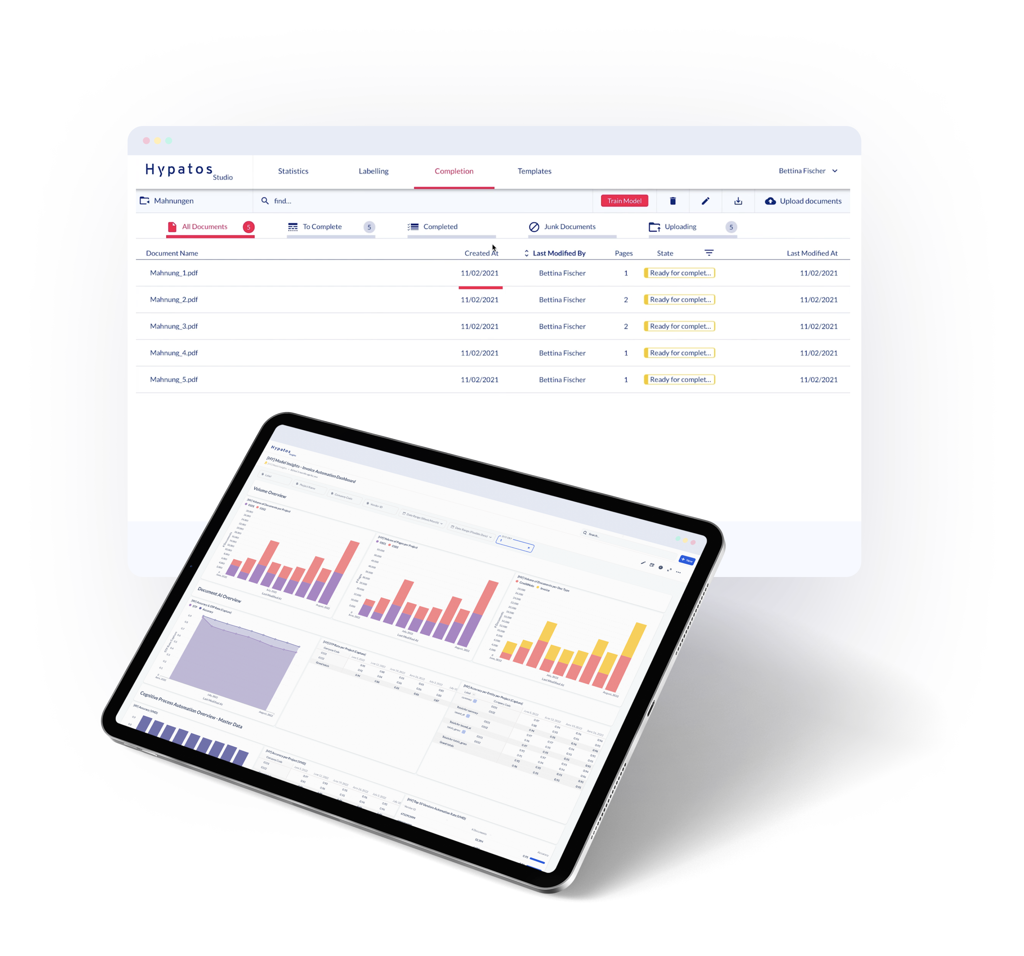


Thank you
Jorge Costa
PS Director
jorge.costa@hypatos.ai
hypatos.ai
Yavuz Güney
Project Manager
Yavuz.guney@hypatos.ai
hypatos.ai
Michael Misterka
Solution Architect
michael.misterka@hypatos.ai
hypatos.ai
Katrin Hamann
Finance Transformation
katrin.hamann@pwc.com
pwc.com
Victoria Knopf
Finance Transformation
victoria.knopf@pwc.com
pwc.com

